Slide 1
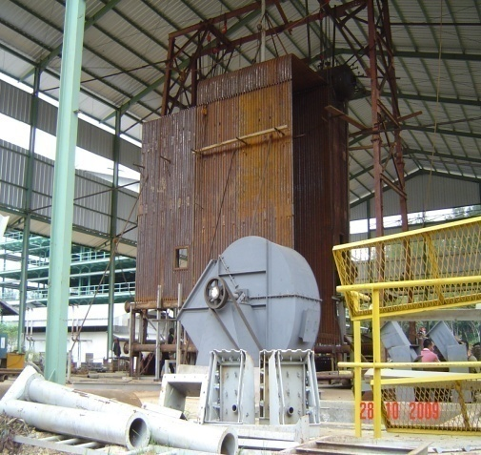
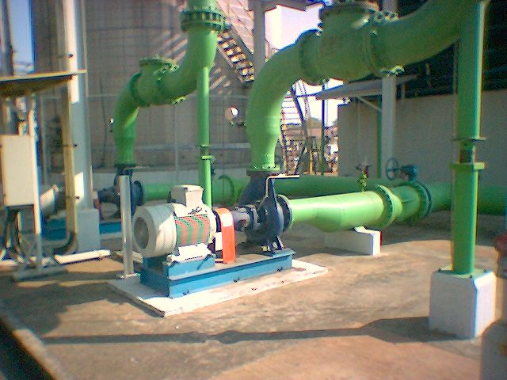
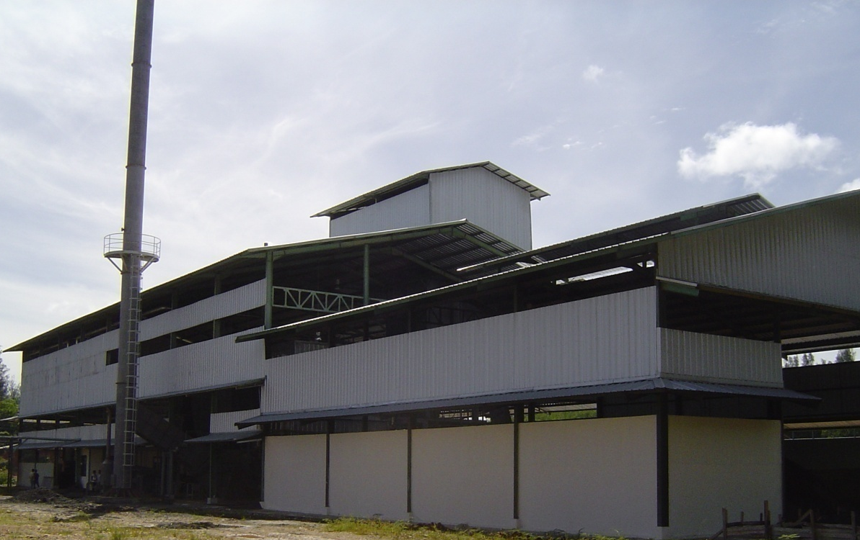
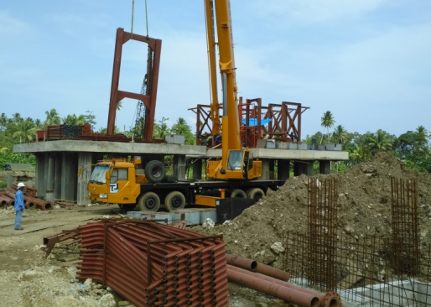
Company profile
PT.VENTURINDO ENGINEERING
Head Office & Work Shop :
Jl.By Pass jomin No.46 Cikampek, Karawang, West Java
Telp. 0264 8385523 Fax. 0264 8385523
Email : Didik.haryadi@venturyndo.com

Slide 2
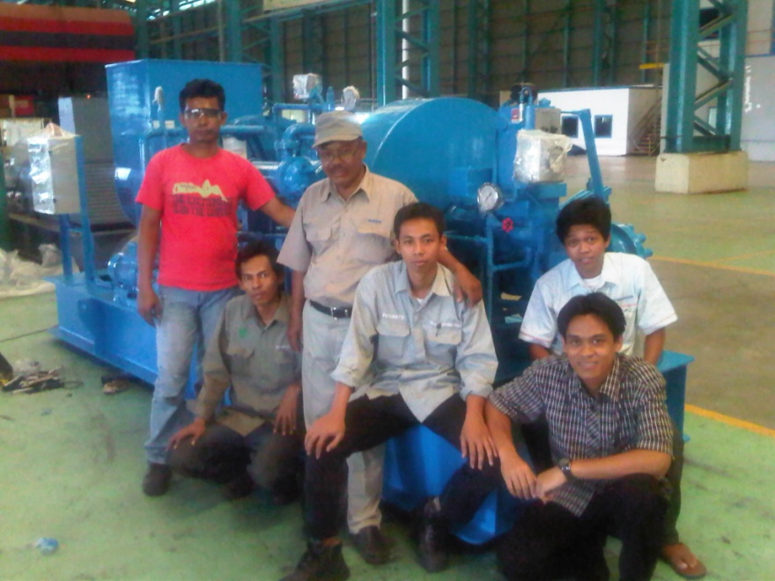
About Us
PT.VENTURINDO ENGINEERING was incorporated in the year 2008 as a private company in Cikampek –West java-Indonesia.with in an attention to provide the best Engineering Design, Workshop Fabrication, Construction, Package Project, Power Plant Industry.
The Pioneer Team

Slide 3
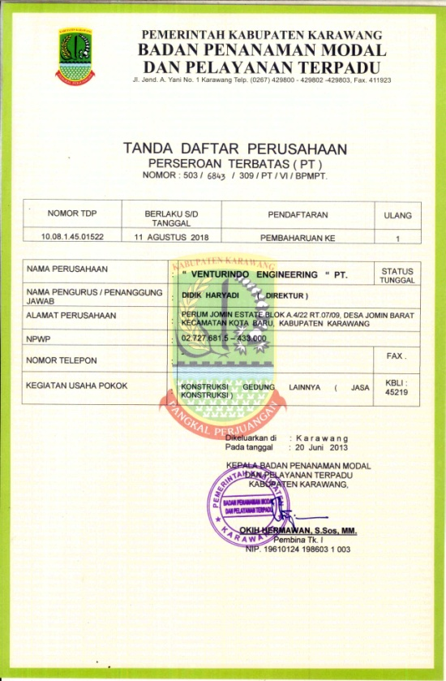
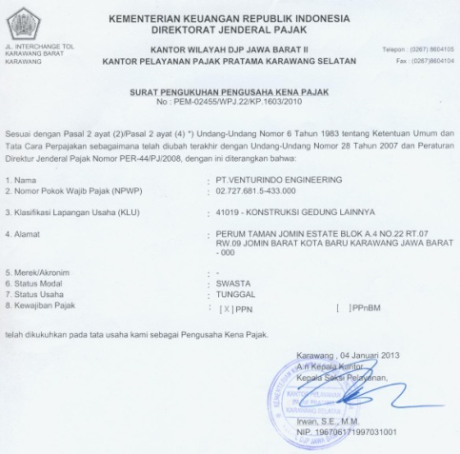
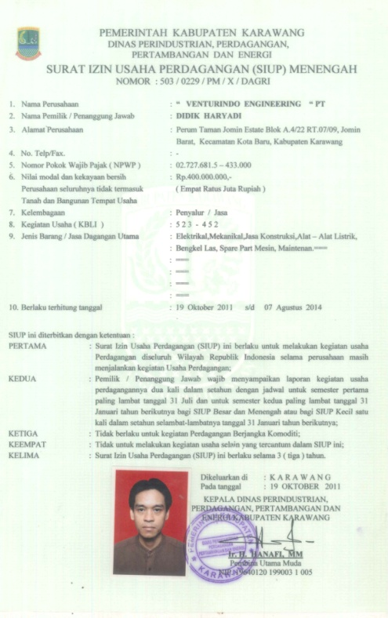
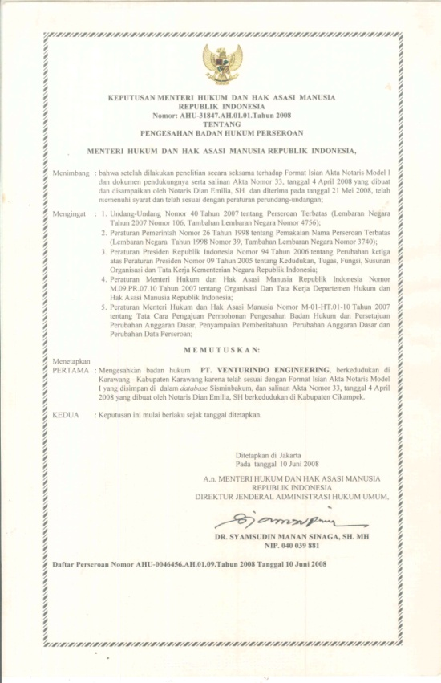
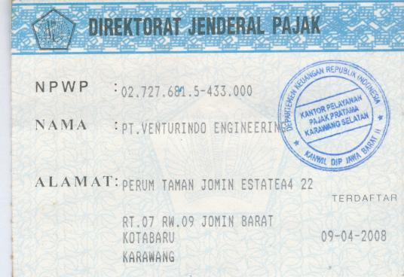
Company legal

Slide 4
COMPANY LEGAL

Slide 5
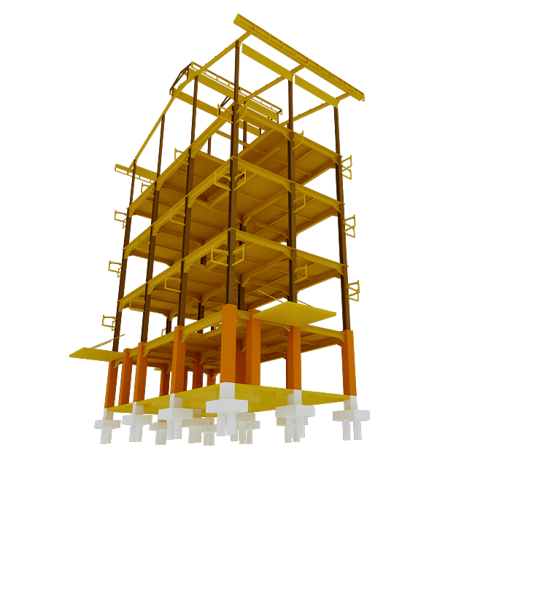
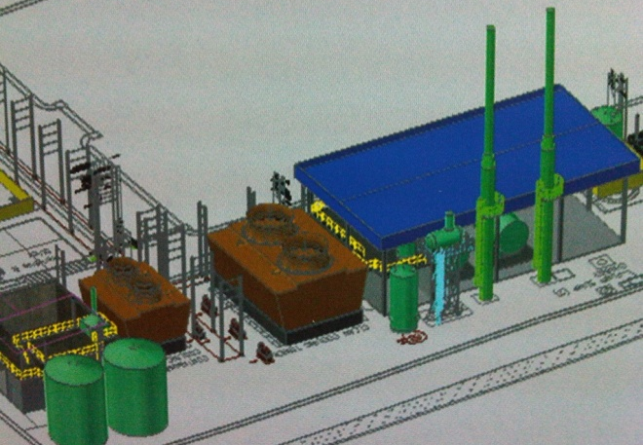
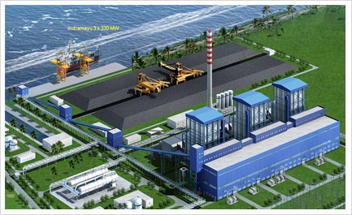
DESIGN ENGINEERING
Standing behind we provide is an engineer dedicated to ensuring all the basic design requirements are meet. Our typical services begin from basic design, engineering , construction and commissioning.

Slide 6
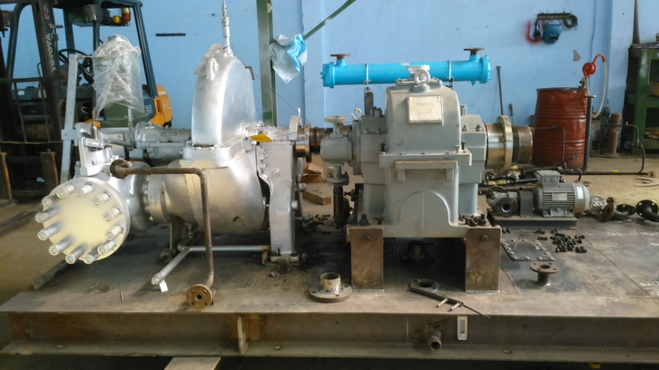
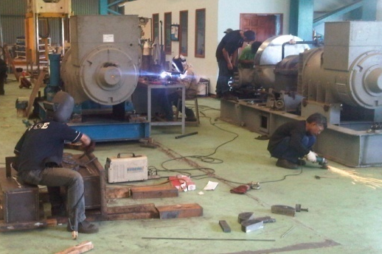
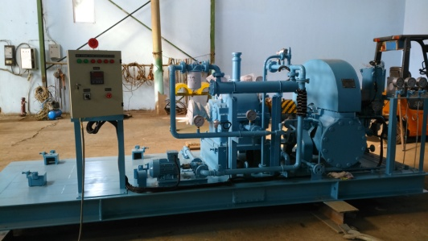
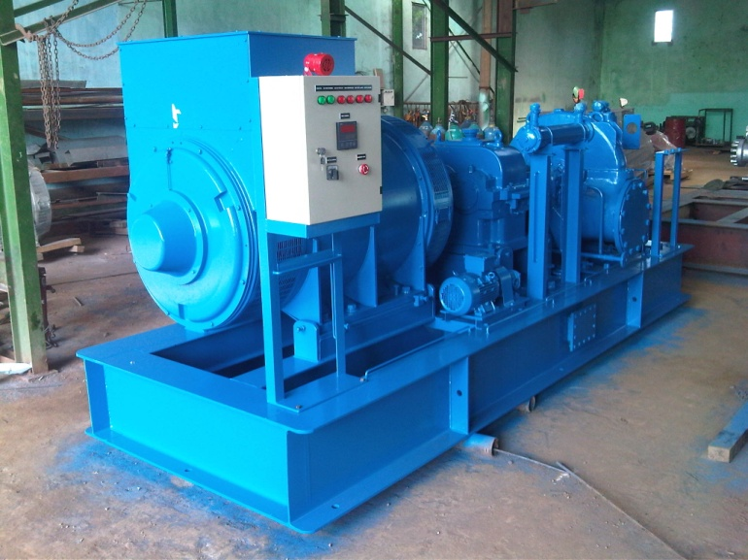
STEAM TURBINE ASSEMBLY
Our expertise in fabrication and applied rotating equipments allows us to apply our knowledge to a wide range of Steam Turbine and Power Plant.We are following very strict quality and test inspection before deliver to our client. only original part and well proven component will be used in our assembling to ensure reliability.

Slide 7
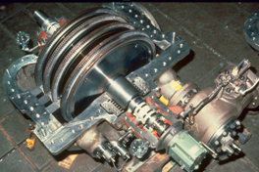
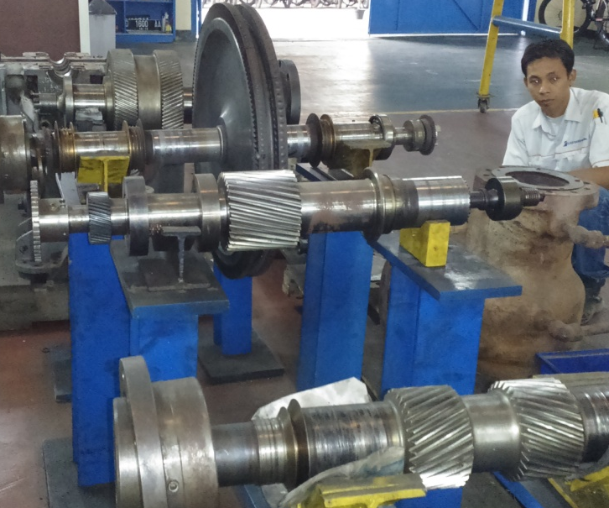
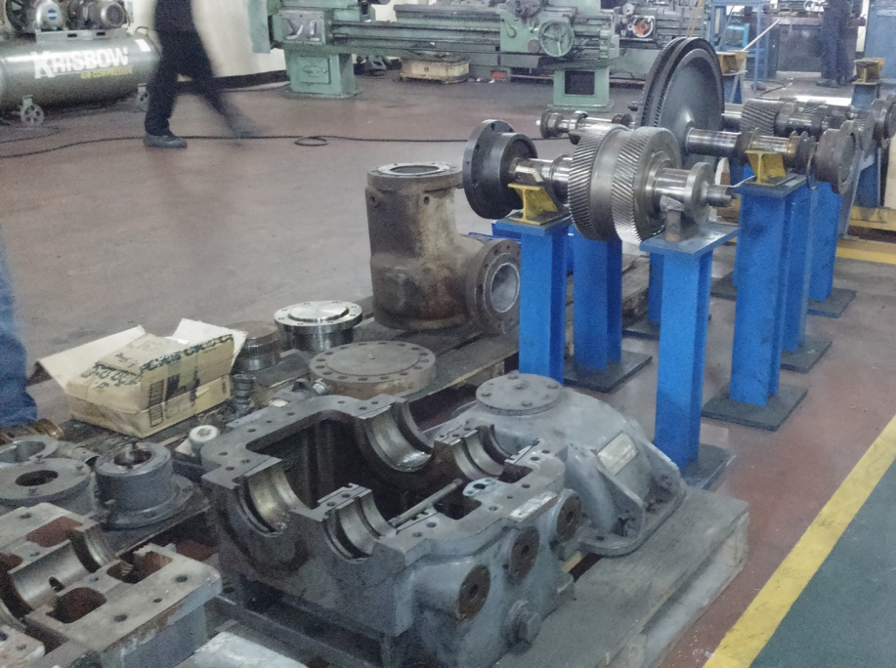
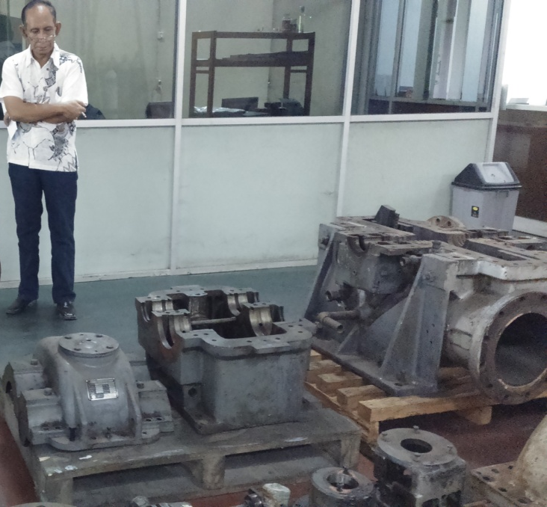
OVERHOUL AND MAINTENANCE
We meet the requirement for Steam turbine overhoul maintenance and service agreements.that truly create value and provide quanifiable positif result.
Operation, Maintenance and sercvices agreements can take many forms incluing ;
Steam Turbine condition monitoring data analysis and support
Overhaul service Steam turbine, Gear box
Reliability improvement program
In-Plant man power supply

Slide 8
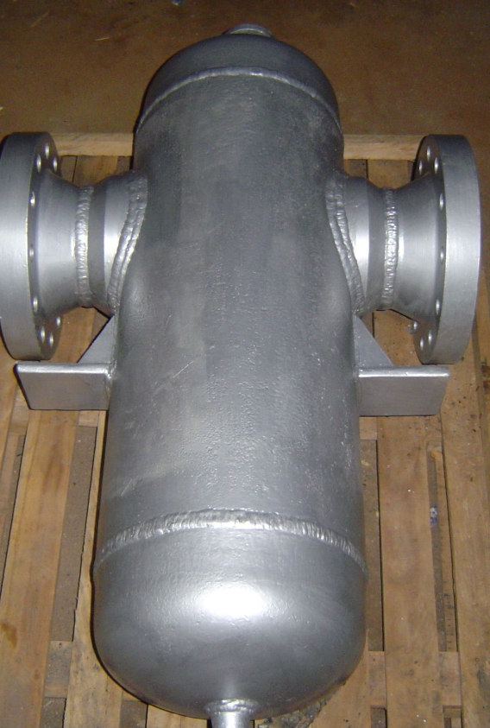
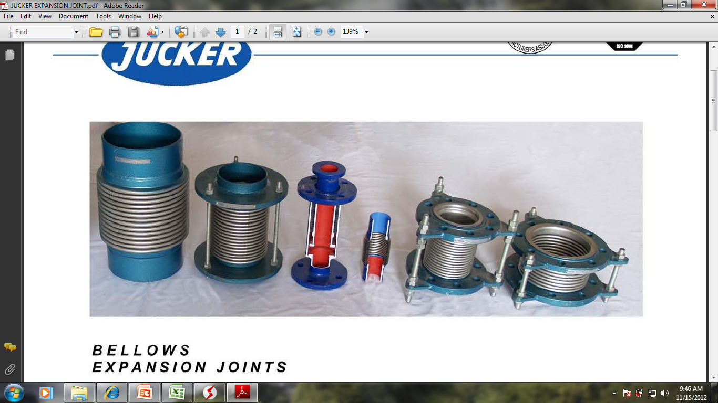
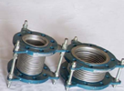
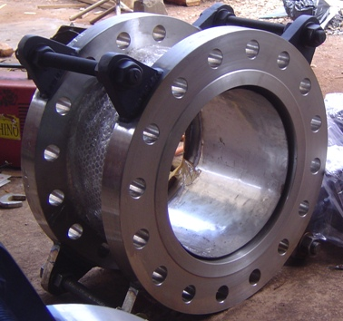
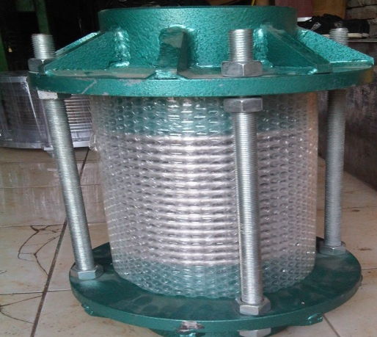
PRODUCT
STEAM SEPARATOR
Type of Separator, moisture drop condensate, coalester, and shyphone.used for superheated or saturated steam, depend on steam requirement.
EXPANSIONT JOINT
We ready to serve your requirement for expansion joint unit. designed and manufactured fully in accordance with the respective EJMA standard and in conformity with the pressure and temperature rating as per ANSI, JIS and DIN

Slide 9
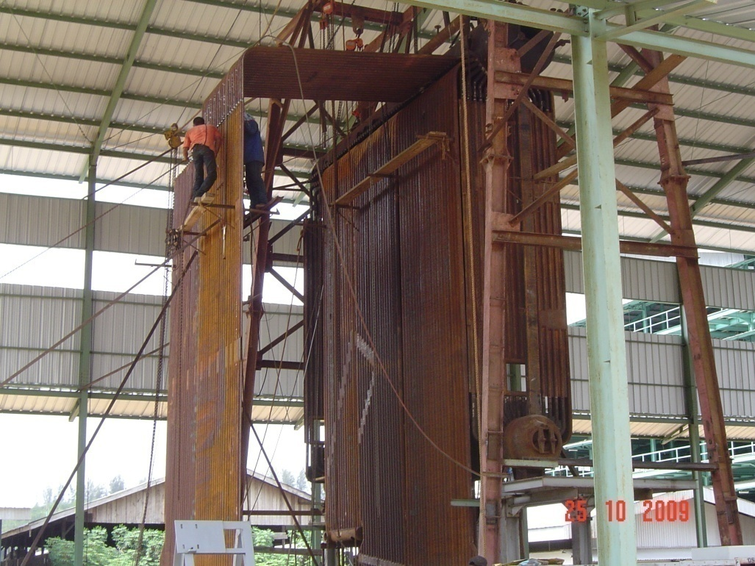
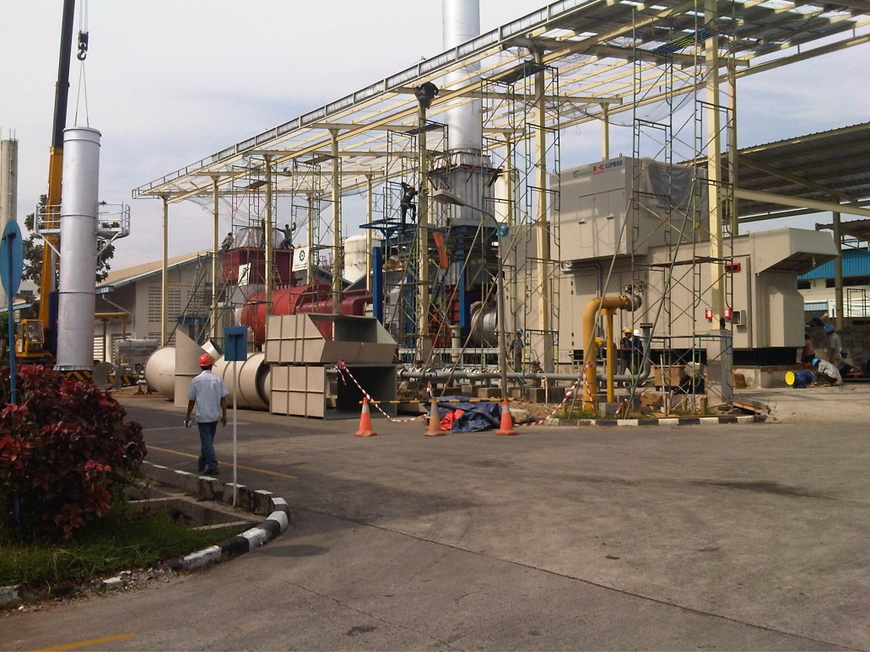
CONSTRUCTION AND INSTALLATION
We meet the requirement for construction, steel structure erection and mechanical services.
The range of services covers shop and field engineering for industrial manufacturing, Palm kernel oil plant, Petrochemicals, Pulp and paper, Fertilizer, Palm oil mill, Refinery and Power generation.

Slide 10
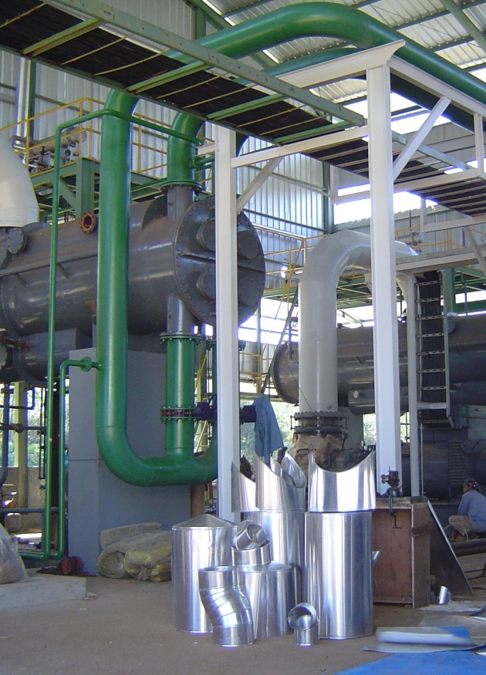
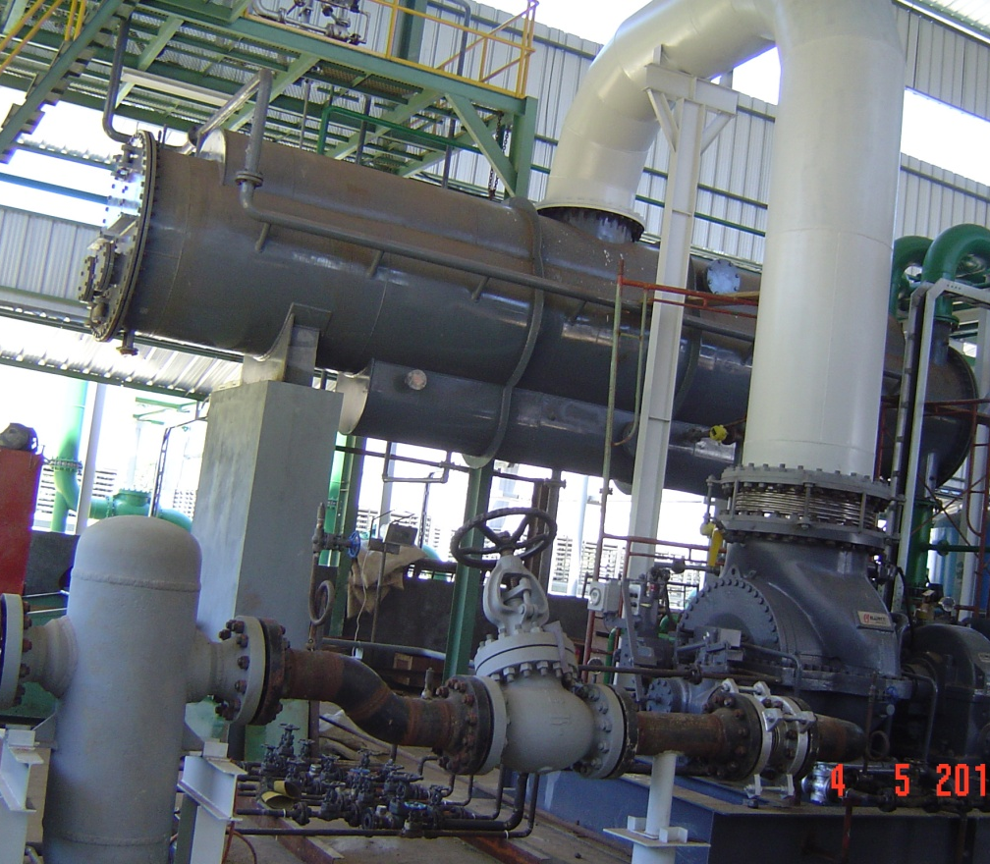
PT.VENTURINDO ENGINEERING is fully prepared to assist you to build Power Generation project in Coal base power plant, Biomass base power plant and Hydro power energy.

Slide 11
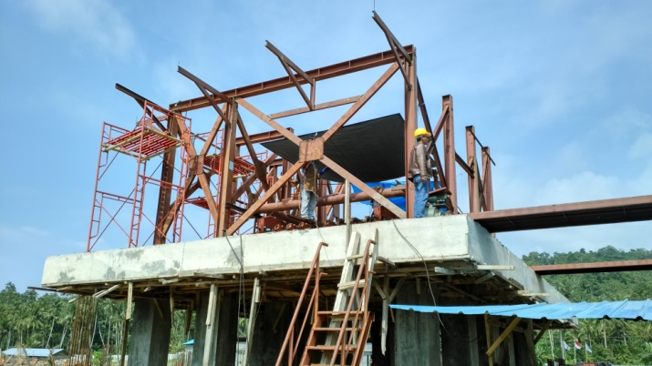

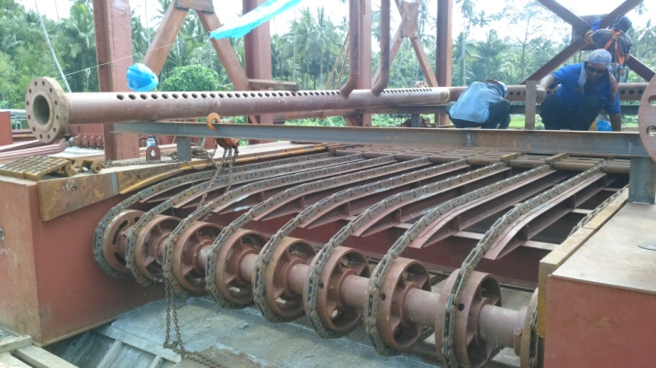
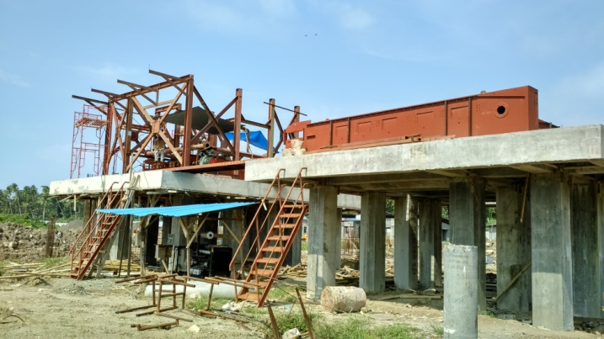
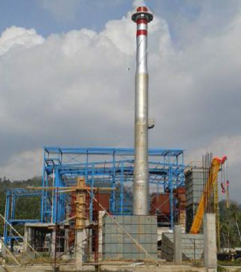
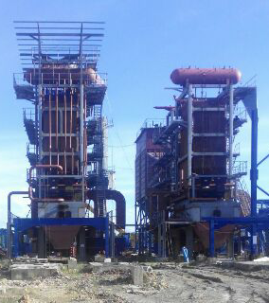
POWER PLANT EXPERIENCE
Installation
Boiler
Steam Turbine
Condenser
Cooling tower, Piping
PT.VENTURINDO ENGINEERING involved for mechanical works at PLTU 2x3MW PLN Talaud, North-SUlawesi

Slide 12
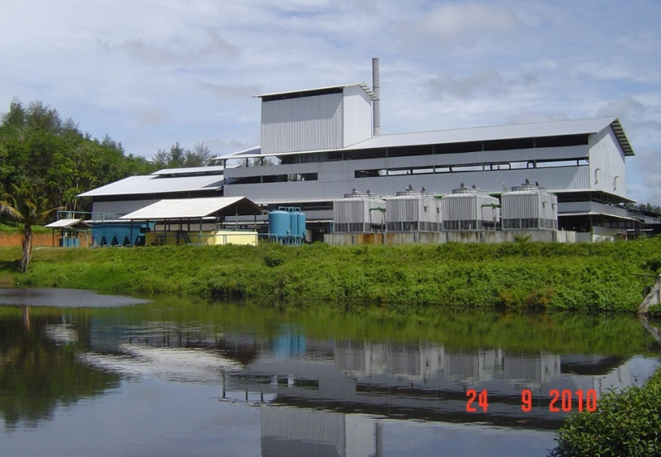
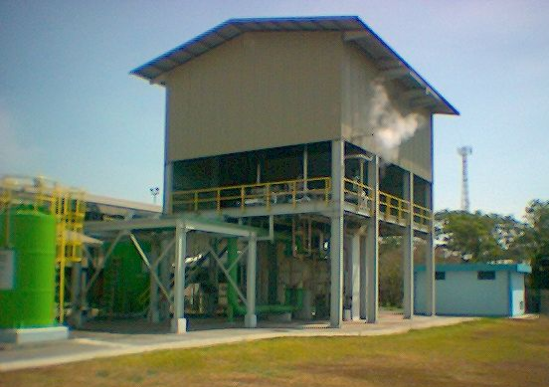
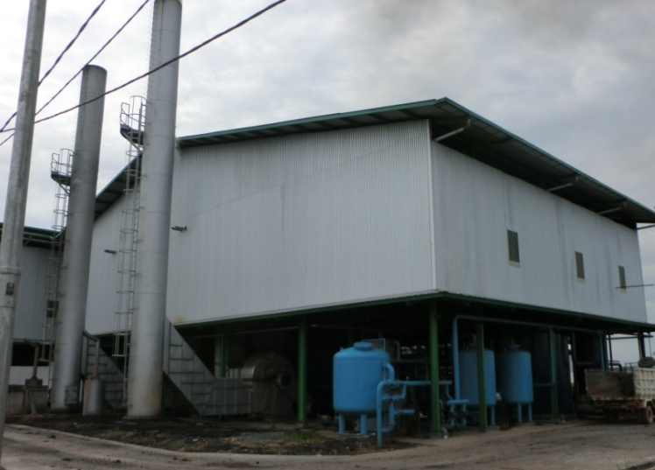
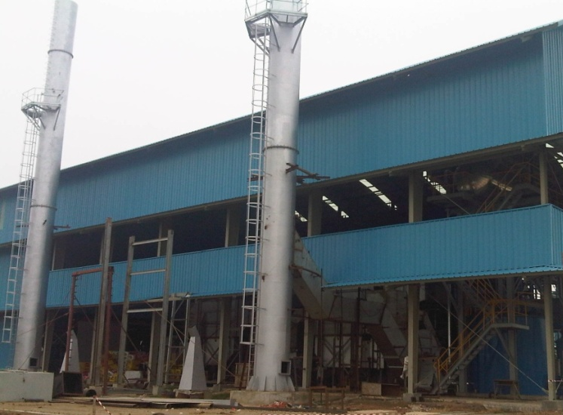
POWER PLANT EXPERIENCE
Biomass Power Plant 2x2 MW Bengkulu
PT.Pamor Ganda
Power Plant 1,8 MW Cikampek
PT.Indo Raya Kimia
Biomass Power Plant 2 MW Kal Tim
PT.Swakarsa
Biomass Power Plant 2x3,5 MW Medan
PT.PN III Sei Mangke, Medan

Slide 13
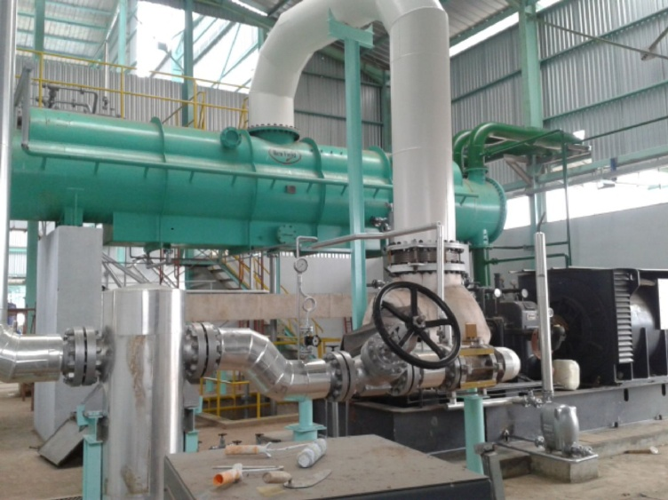
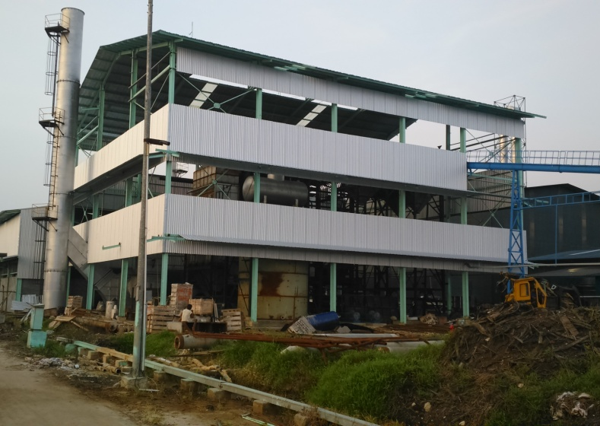
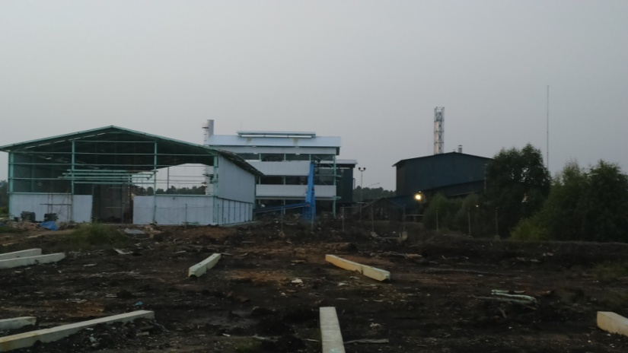
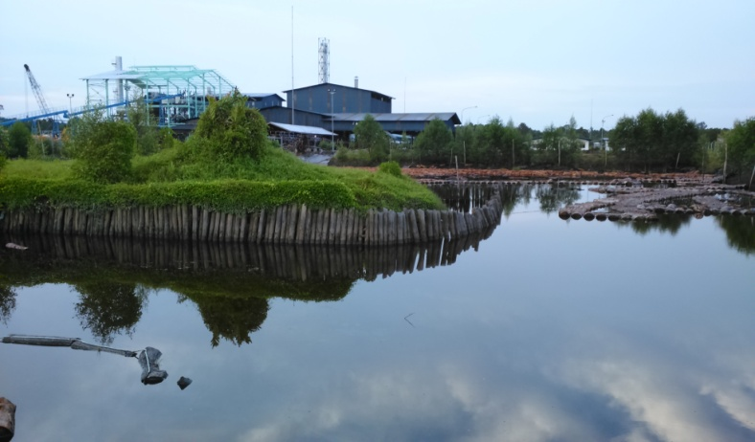
POWER PLANT EXPERIENCE
Biomass power plant 3MW Sampoerna Agro

Slide 14
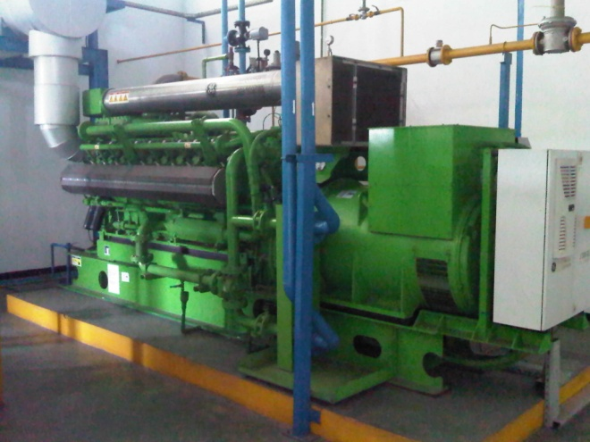
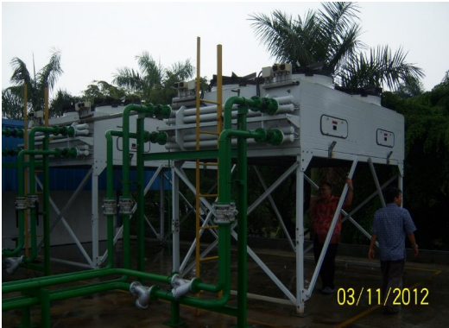
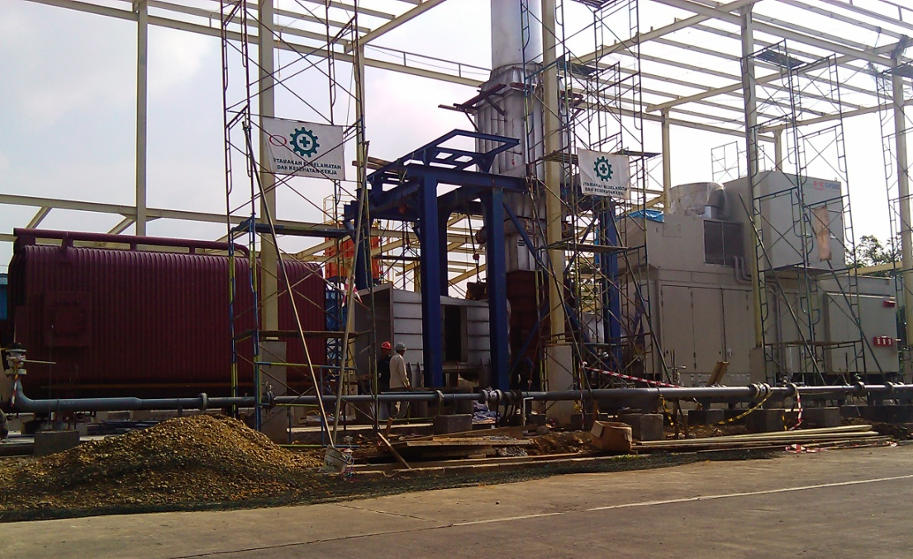
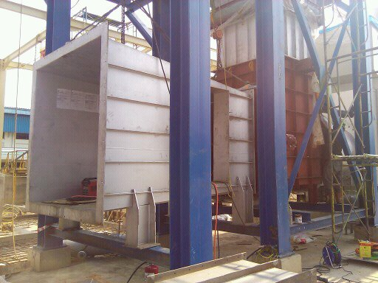
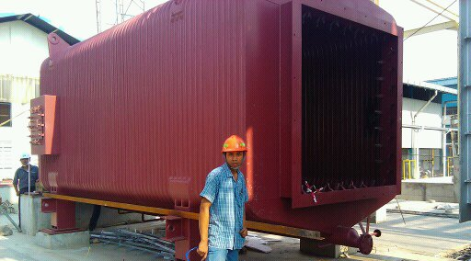
GAS ENGINE, GAS TURBINE
GE Jenbacher 2x1000KW
KAWASAKI Gas Turbine 5,7MW completed with Heat Recovery Boiler

Slide 15
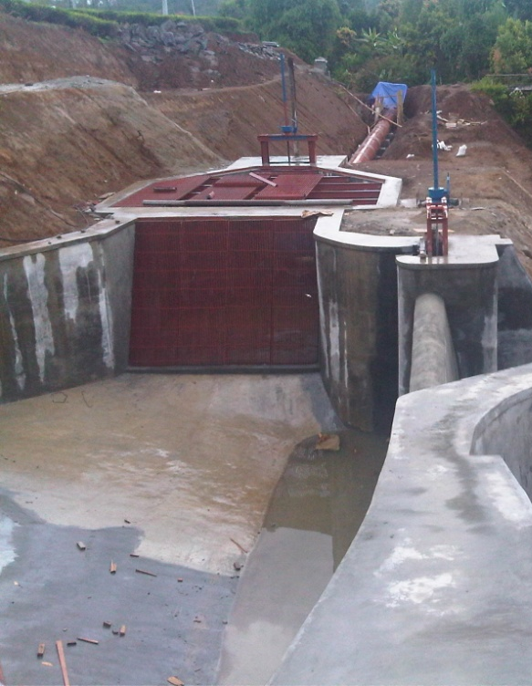
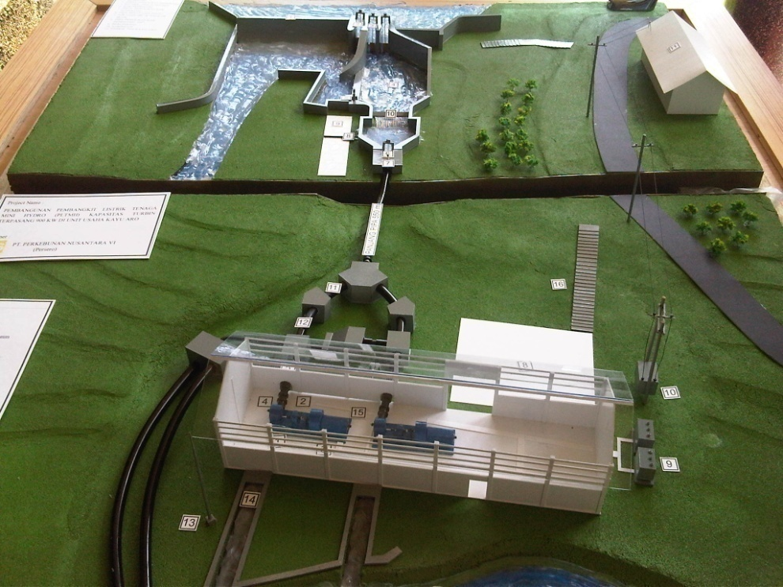
Micro Hydro Power
PLTMH
Micro hydro construction :
Intake
Weir
Forebay and spilbay
Head race
Penstock
Tail race
Power house

Slide 16

Power plant, Capacity 1,4MW PT.Indo Raya Kimia, Cikampek Fuel : Steam recovery from process | Power plant, Biomass Capacity 2.6 MW PT. Swakarsa, Muara Wahau, Kal-Tim Fuel : Mixed shell and fiber
Power Pant, Coal base Capacity 5.6 MW Install Turbine. PT. Medco Ethanol Indonesia. Lampung | Power Plant, Biomass Capacity 2x3.5 MW PT. Wijaya Karya. PTPN III Medan Fuel : Mixed shell, fiber and EFB
Power Plant, Biomass Capacity 2x2 MW PT. Pamor Ganda. Bengkulu. Fuel : Mixed coal and shell | Power Plant, Biomass Capacity 2.6 MW PT. Amarta Karya. PTPN III Medan Fuel : Mixed shell, fiber and EFB
Microhydro Power 0.9 MW PT.BARATA MEDAN, PTPN VI. Jambi | Power Plant ,Gas turbine 5,7 MW PT. Summi Rubber Indonesia. Fuel : Gas CH4
Power Plant, Capacity 1,8MW PT.Astra Agro Lestari, Kumai Fuel : Mixed shell and fiber | Power plant, Biomass Capacity 3MW PT.Sampoerna Agro, Kep.Meranti Fuel : Mixed shell and sagoo bark
 | Power Plant, Capacity 2x3MW Pt.Bousted Maxitherm, PLN Talaud Sulawesi Fuel : Coal

Slide 17
CONTACT US :
PT.VENTURINDO ENGINEERING
Maintenance, Engineering & Contractor
Head Office & Work Shop :
Jl.By Pass jomin No.46
Cikampek, Karawang, West - Java
Telp. 0264 8385523
Fax. 0264 8385523
Email :
Didik.haryadi@venturyndo.com
engineering@venturyndo.com

